Slide 1

Institute of Professional Studies, Gwalior
Subject
BUSINESS MANAGEMENT
SUBMITTED TO- SUBMITTED BY
NEHA YADAV ABHISHEIKH SRIVAS

Slide 2
CONTENT
ABOUT MANAGEMENT
DEFINE MANAGEMENT
FUNCTION OF MANAGEMENT

Slide 3
WHAT IS MANAGEMENT ?
Definition : “ The process of working with people and resources to accomplish organizational goals.”
Managers must be :
effective: achieve organizational goals.
efficient : achieve organizational goals with minimum waste of resources.

Slide 4
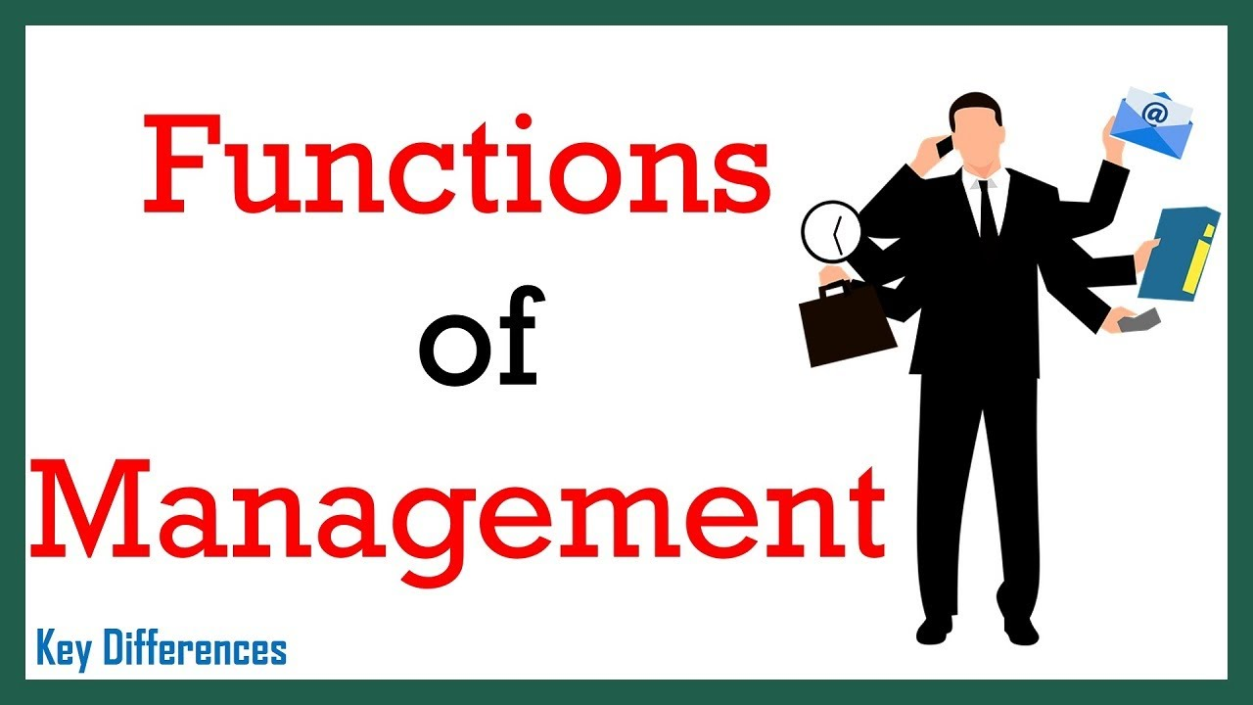

Slide 5
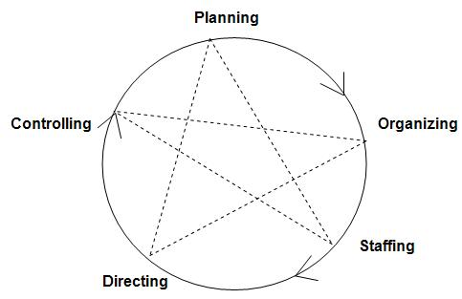

Slide 6
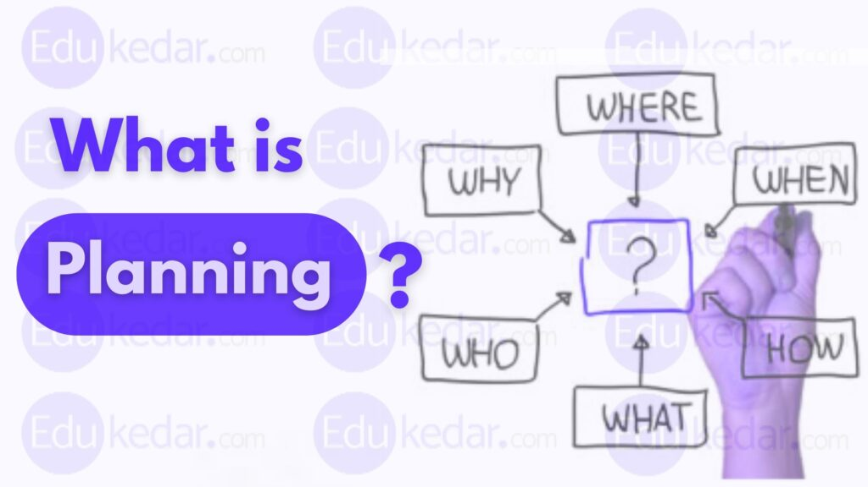

Slide 7
PLANNING
According to KOONTZ, “Planning is deciding in advance - what to do, when to do & how to do. It bridges the gap from where we are & where we want to be”.
A plan is a future course of actions. It is an exercise in problem solving & decision making. Planning is determination of courses of action to achieve desired goals.

Slide 8
IMPOTANCE OF PLANNING
Planning provides directions
Planning reduces the risks of uncertainty
Planning reduces overlapping and wasteful activities
Planning promotes innovation ideas

Slide 9
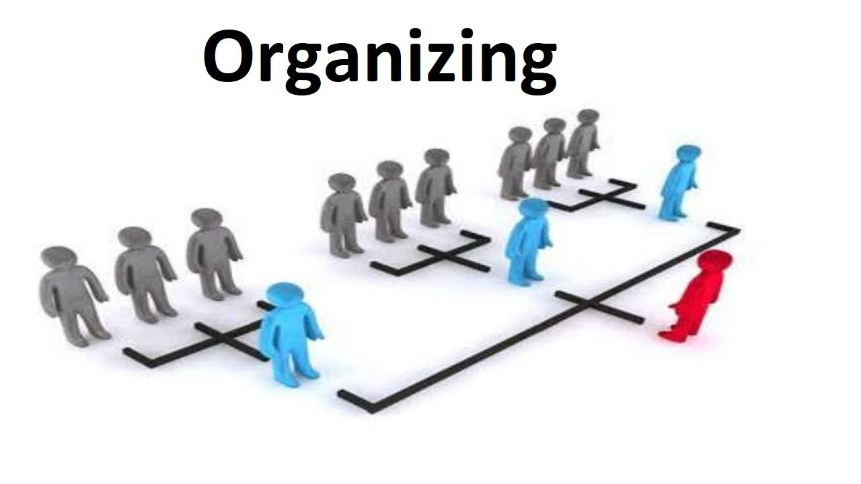

Slide 10
Organizing
Definition: Organization refers to a collection of people, who are involved in pursuing defined objectives. It can be understood as a social system which comprises all formal human relationships.
It is the process of bringing together physical, financial and human resources and developing productive relationship amongst them for achievement of organizational goals.

Slide 11
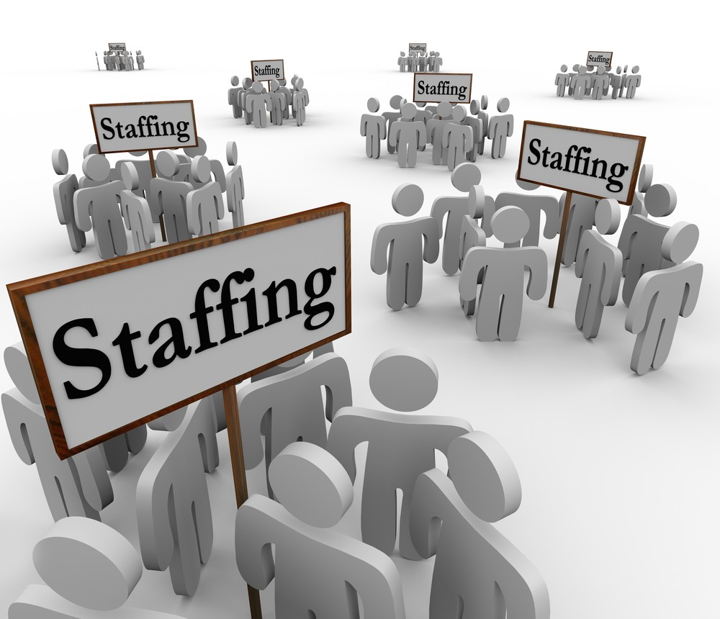

Slide 12
Staffing
According to Kootz & O’Donell,
“Managerial function of staffing involves manning the organization structure through proper and effective selection, appraisal & development of personnel to fill the roles designed un the structure”. Staffing involves:
Definition - staffing is an operation of recruiting the employees by evaluating their skills and knowledge before offering them specific job roles accordingly.

Slide 13
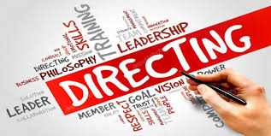

Slide 14
DIRECTING
Definition – Directing function of management refers to the process of instructing, guiding, counseling, motivating and leading people in the organization to achieve its objectives. It is one of the key managerial functions performed by every manager.

Slide 15
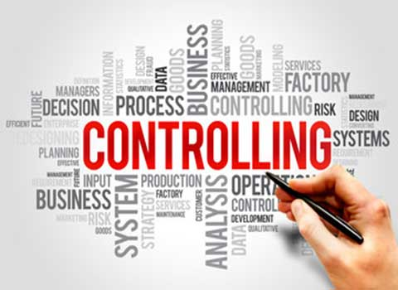

Slide 16
Dfinition of Contreolling
Controlling means giving instructions to employees and making sure that the instructions are being followed as desired by the management.
Controlling can be defined as a function of making sure that actions of the employees of an organization are directed towards the attainment of a common goal and the work is being performed as planned by the management.

Slide 17


